Slide 1
Implementation of the Linear Time Algorithm for Finding the Kernel of a Star-Shaped Polygon
BATUHAN TOSYALI CS478
21702055

Slide 2
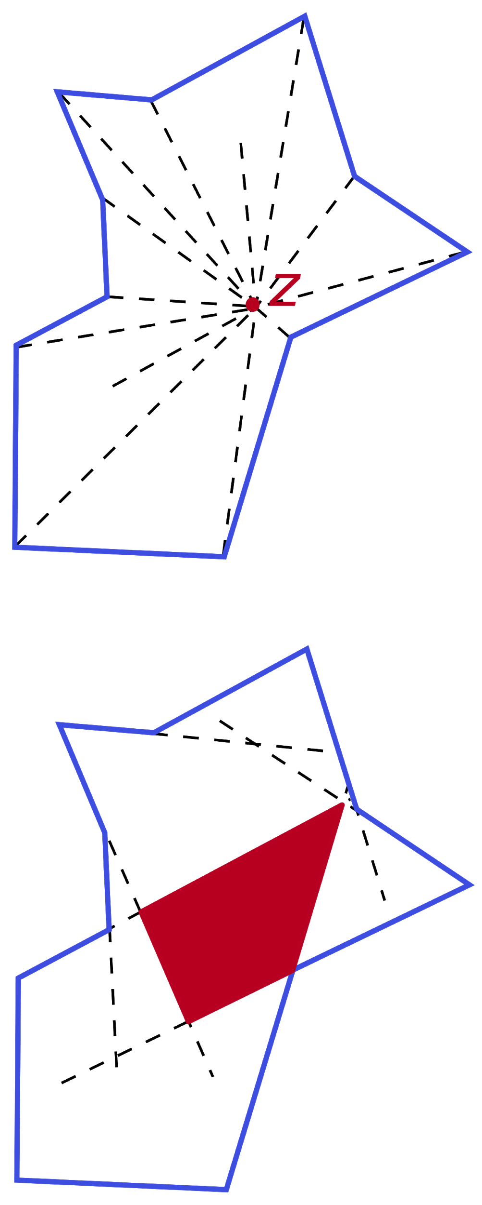
What is a star shaped polygon
A simple polygon P is star-shaped if there exists a point z not external to P such that for all points p of P the line segment zp lies entirely within P.[1] (making every convex polygon a star shaped polygon )
And also, A simple polygon P is convex if its interior is a convex set.[1]

Slide 3
What is the kernel
The kernel K(P) of a simple polygon P is the locus of the points internal to P which can be joined to every vertex of P by a segment totally contained in P.[2]
Basically it is the loci of points where you can see the entire polygon.
But we know that, the crucial part is that kernel area can be expressed as, “if one considers the boundary of P as a counterclockwise directed cycle, the kernel of P is the intersection of all the half-planes lying to the left of the polygon's edges.”[2],
Therefore, our problem turns(!) into a problem of finding the intersection of halfplanes.

Slide 4
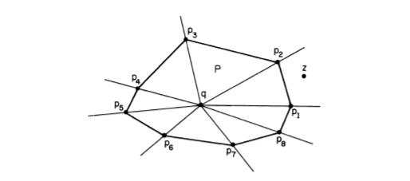
Why do we need to find kernel
After finding the kernel polygon we can order the edges using preprocessing with their angular order and later query them with quick sort O(logn) as we seen in class.

Slide 5
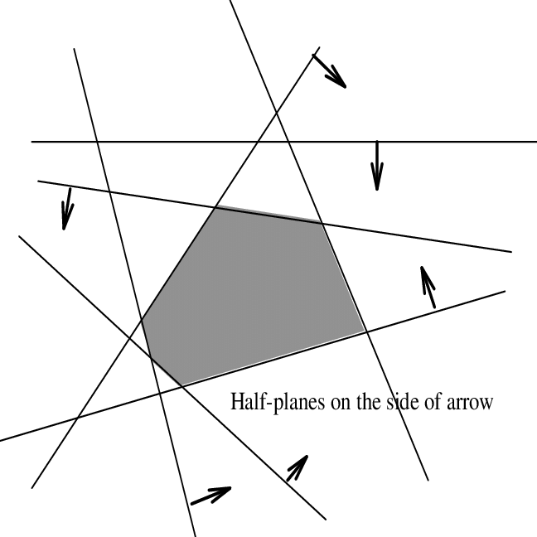
Finding the lower bound of intersection of half planes
Shamos and Hoey have proposed an algorithm to find the kernel area using the intersection of half planes which is O(nlogn). [3]
Furthermore they also found the lower bound for this problem to be the O(nlogn).[2]
Does that mean the lower bound for finding the kernel are is O(nlogn) ?

Slide 6
NO
Problems are not really the same, we know the order of the half-planes in finding the kernel, but we do not know their order in the problem of finding the intersection of half-lines.
D.T. Lee exploits this facts, and constructs an algorithm which works in O(n)

Slide 7
Notations and preparations.
We will be using a circular linked list structure which holds the vertices and edges in counterclockwise direction for both Kernel and the polygon . Where, the edges are directed according to their predecessor and successor vertex.
We will be constructing K(i+1) from Ki for each vertex of our polygon.
The kernel of the polygon can be either bounded or unbounded polygon. Which means the list can be either circular or linear.
When kernel is unbounded, the start and end halfline will be noted as Aviei-1 and ei+1viA

Slide 8
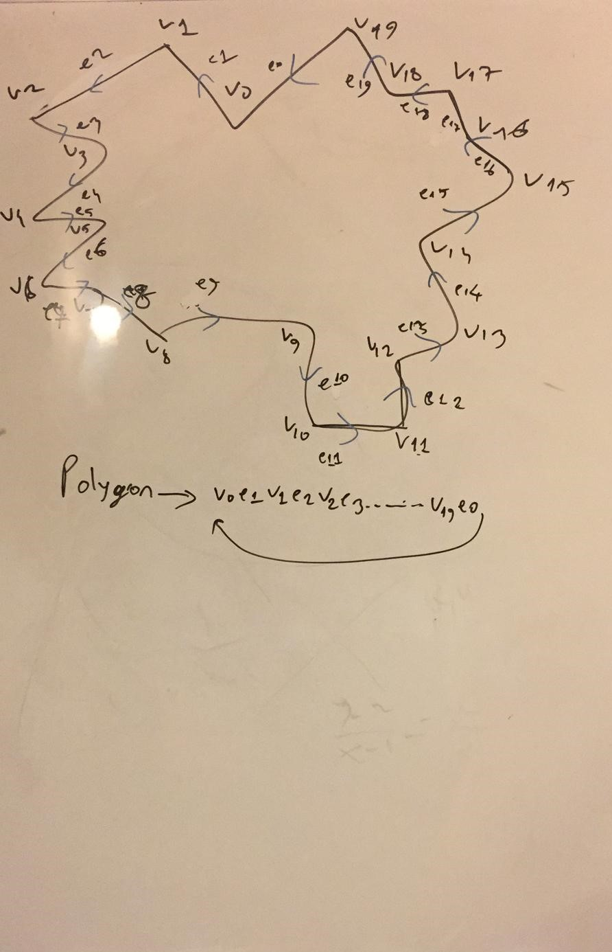

Slide 9
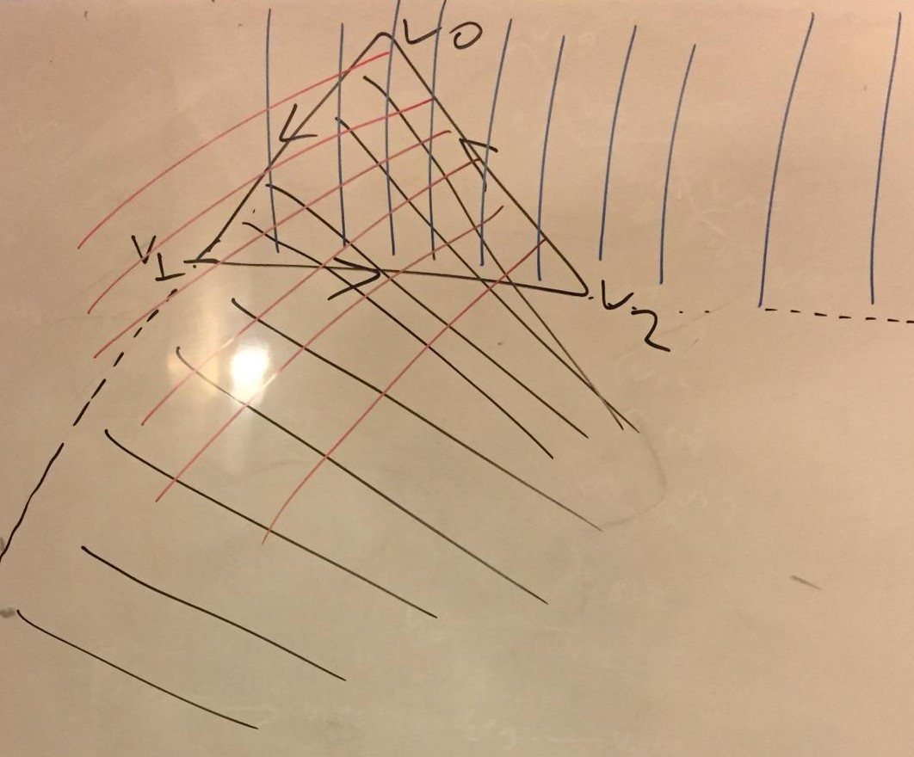
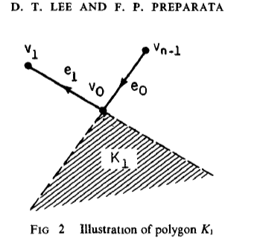
Notations and Preparations
The first vertex and edges of the kernel list shall be determined. Which will be determined from the halfplanes directed from edges of a reflex vertex.
It is a reflex vertex because if it was a convex vertex, the halfplanes would include all of the polygon

Slide 10
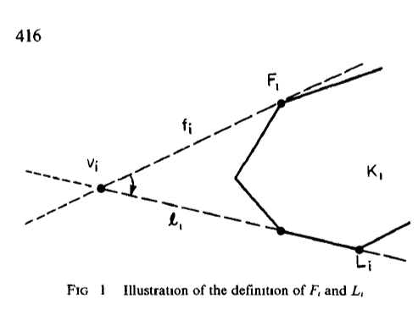
Notations and preparations.
Finally, most crucial part is the supporting points F and L for each kernel polygon. These are the vertex of the kernel polygon.
These supporting points are determined for each polygon P’s vertices suore ch that, F and L will be the farthest from the current Polygons point, and there should not be more degrees than pi between F and L clockwise.[2]

Slide 11
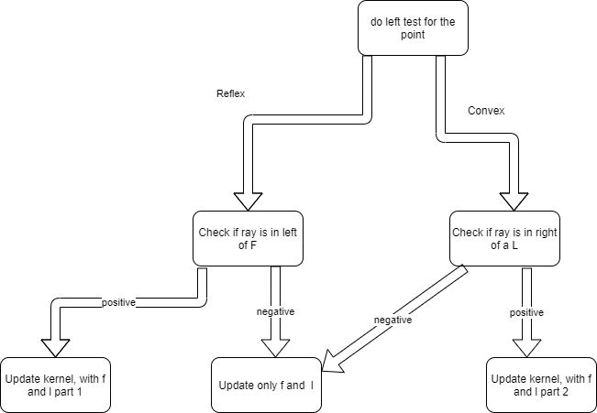
The algorithm

Slide 12
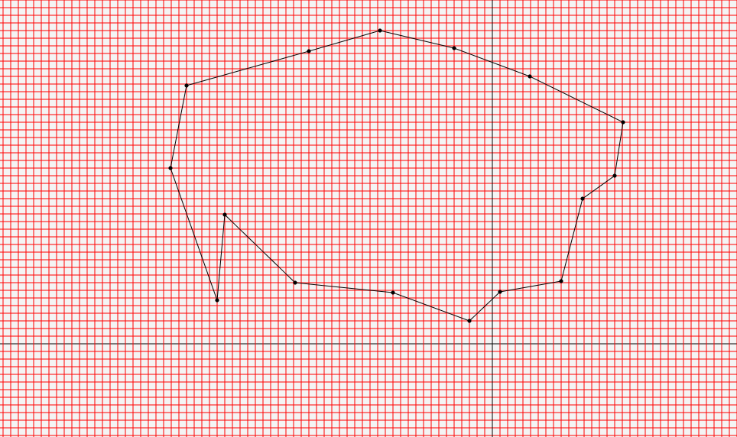

Slide 13


Slide 14
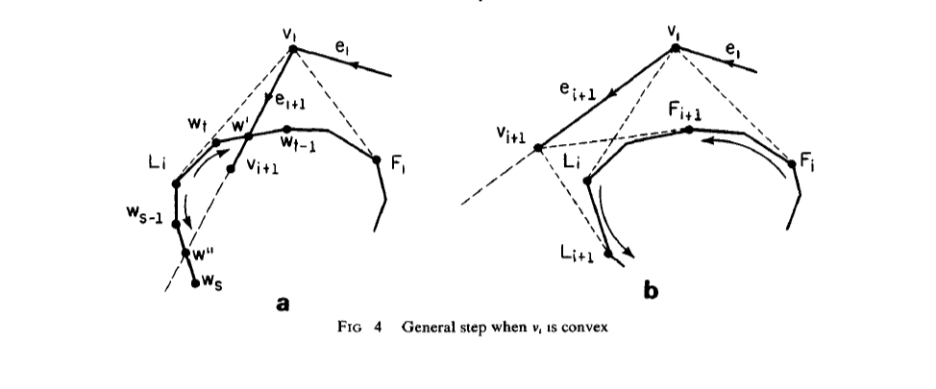
Vertex and convex cases

Slide 15
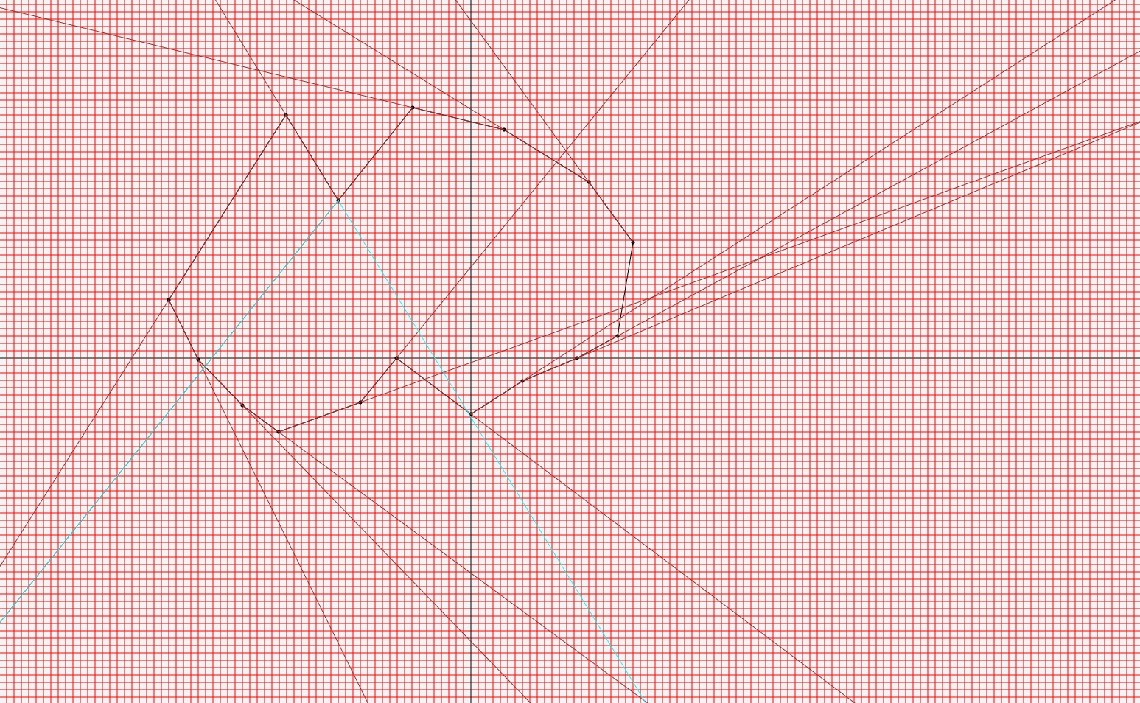
Checking the rays position accorindg to F and L

Slide 16
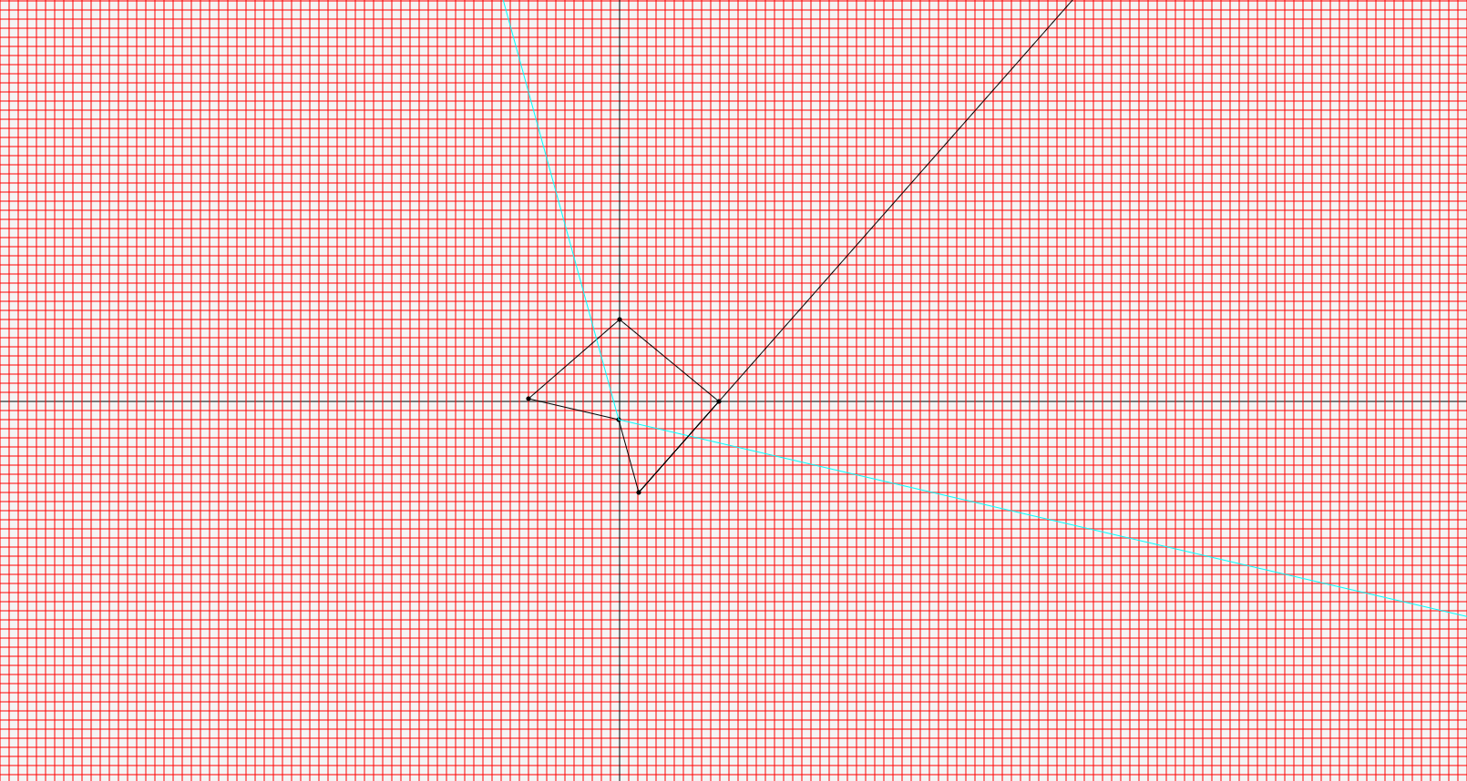

Slide 17
Case 1-a
Find intersection of current ray and kernel structure.(Counterclockwise from the F ). If not exit without kernel ( If reached L )
Try to find a second intersection (traverse until vertex L from F counterclockwise )
If you can’t find that means polygon is unbounded (not simple )
Check the slopes of unbounded rays from the kernel, if the ray from current vertex’s slope is between them, there must exist a second intersection.
Find the second intersection and discard the vertices and edges in the middle of the intersections
Otherwise Discard the counterclockwise part of the intersection.

Slide 18
Case 1-b
Find new F and L
search through a point wi on kernel where a ray starting from wi+1 and directed like (wi+1,vi) is at the right of the point wi, starting from point F going counterclockwise
search through a point wi on kernel where a ray starting from wi+1 and directed like wi+1vi is at the left of the point wi, starting from point F going counterclockwise

Slide 19
Case 2-a
Find intersection of current ray and kernel structure(clockwise from L). If not exit without kernel ( reached F )
Try to find a second intersection (traverse until vertex F from L clockwise )
If you can’t find that means polygon is unbounded (not simple )
Check the slopes of unbounded rays from the kernel, if the ray from current vertex’s slope is between them, there must exist a second intersection.
Find the second intersection and discard the vertices and edges in the middle of the intersections
Otherwise Discard the counterclockwise part of the intersection.

Slide 20
Case 2-b
Find new F and L
search through a point wi on kernel where a ray starting from wi+1 and directed like wi+1vi is at the right of the point wi, starting from point F going counterclockwise
if l is bounded search through a point wi on kernel where a ray starting from wi+1 and directed like wi+1vi is at the left of the point wi, starting from point F going counterclockwise

Slide 21
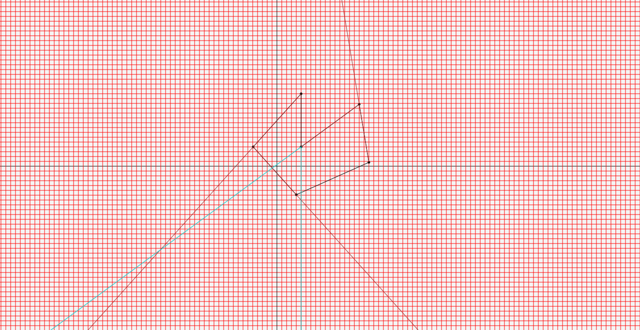

Slide 22


Slide 23
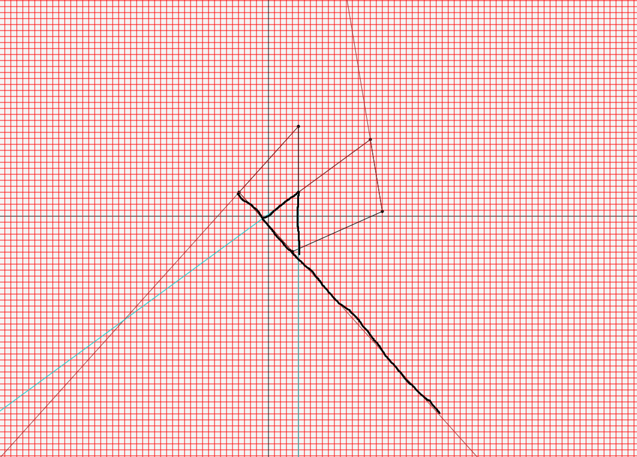

Slide 24
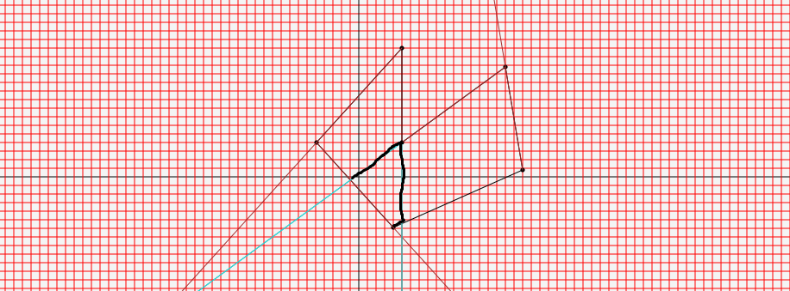

Slide 25
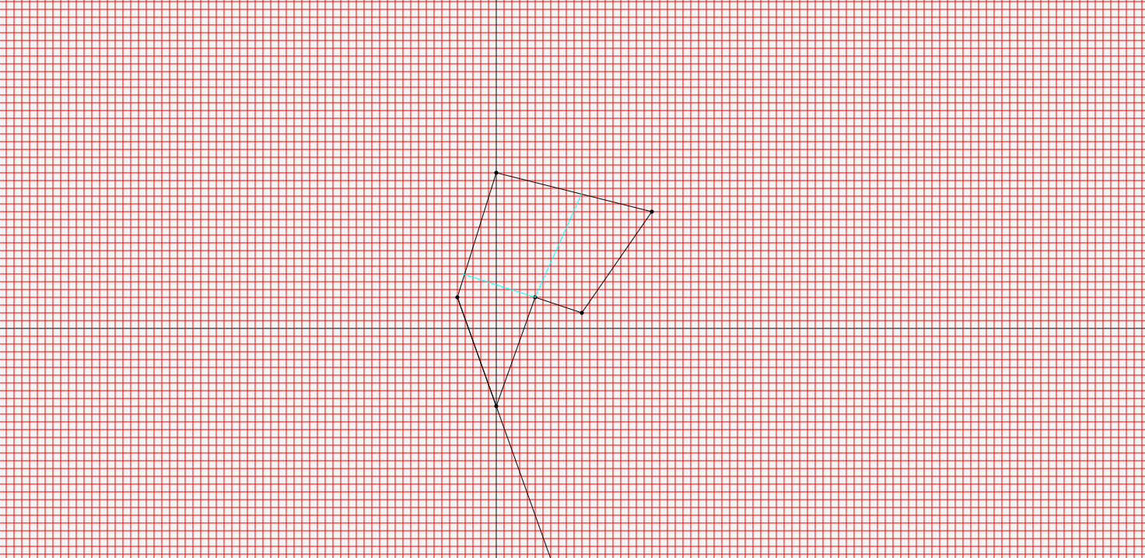

Slide 26
Justification of O(n)
“We begin by considering intersection updates. In case (1.a) (when the algorithm does
not terminate), we scan K, starting from F, both clockwise and counterclockwise (this scan
also finds Fi). Let v, be the total number of edges visited before finding the two
intersections w' and w'’. This process actually removes v, - 2 edges from K, (those
comprised between w, and wt-1 in Figure 3(a)), and since each of the removed edges is
collinear with a distinct edge of P, we have sum(v, - 2) _< n. Thus sum(v),, the total number of
vertices visited by the algorithm in handling case (1.a), is bounded above by 3n, Le. it is
O(n). The same argument, with insignificant modifications, can be made for case (2.a)” [2]

Slide 27
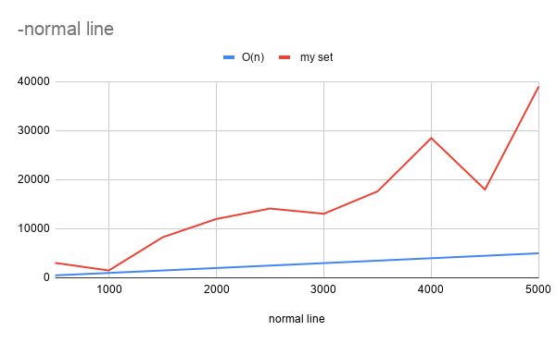

Slide 28
References
1-D. T. Lee and F. P. Preparata, “An Optimal Algorithm for Finding the Kernel of a Polygon,” Journal of the ACM (JACM), vol. 26, no. 3, pp. 415–421, 1979.
2- F. P. Preparata and M. I. Shamos, “Computational Geometry,” 1985.
3- SHAMOS, M I, AND HOEY, D Geometric intersection problems 17th Annual Syrup on Foundanons of Computer Science, Houston, Tex, Oct 1976, pp 208-215 (1EEE)

